Slide 1
Windmill Turbines to place next to highways and train tracks
Presentation #2
Belal Aly

Slide 2
TABLE OF CONTENTS
01
02
06
03
07
Objective Adjustment
05
Research
Designs
Purchases
Solidworks
Timeline

Slide 3
OBJECTIVES
Previous
Comparing 2 designs to my one of my own
Perform simulations and calculations for efficiency
Determine the best design out of the 3
Current
Focus on my own new design
Perform simulations and calculations for efficiency
Build and physically test the turbine rotation speed
Note: This project would apply in many wind energy capture scenarios

Slide 4
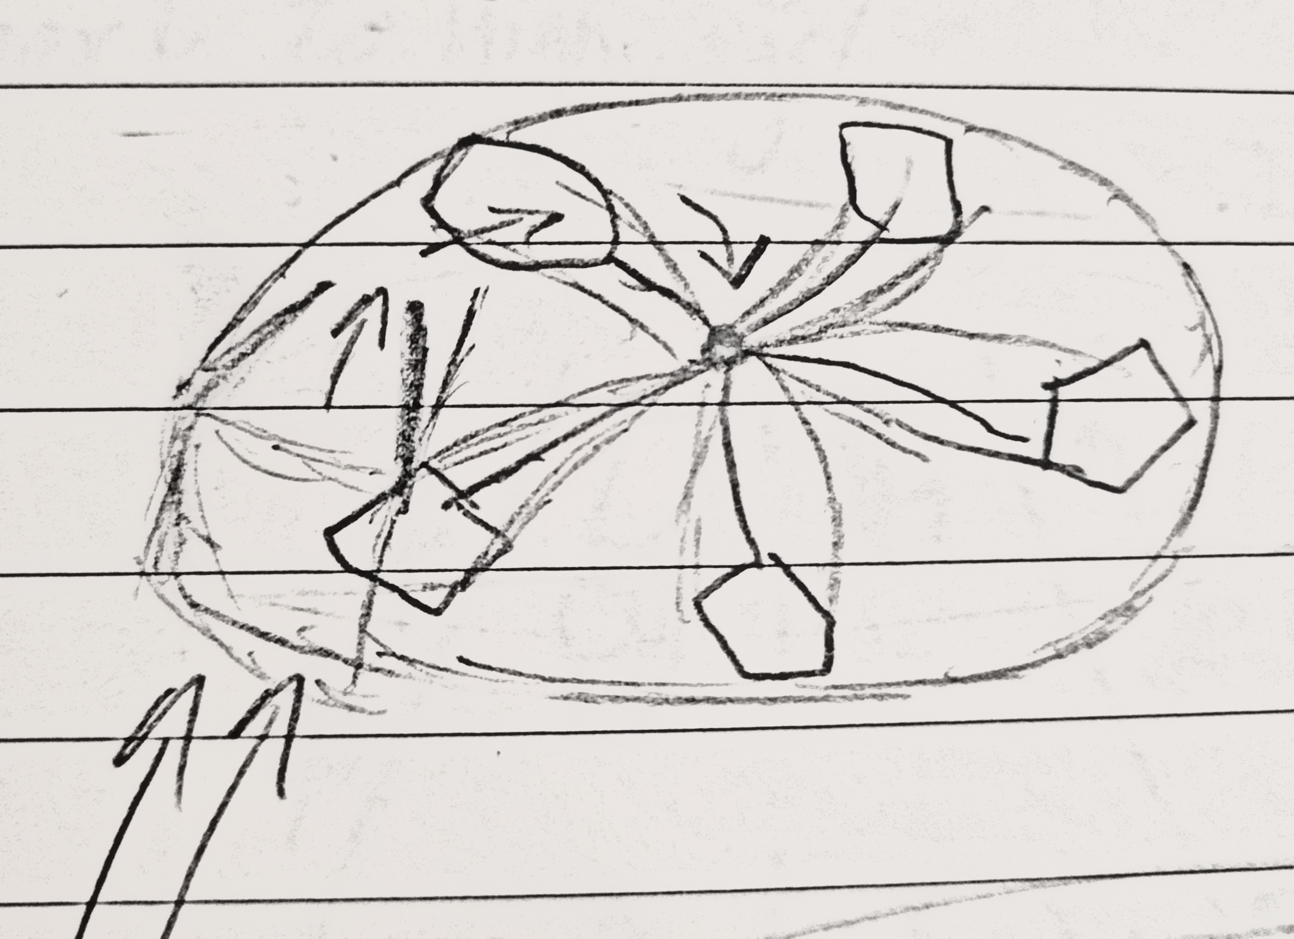
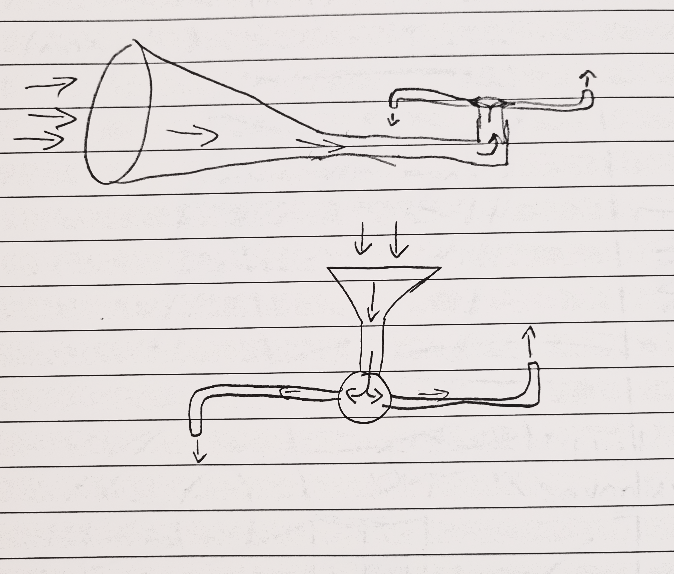
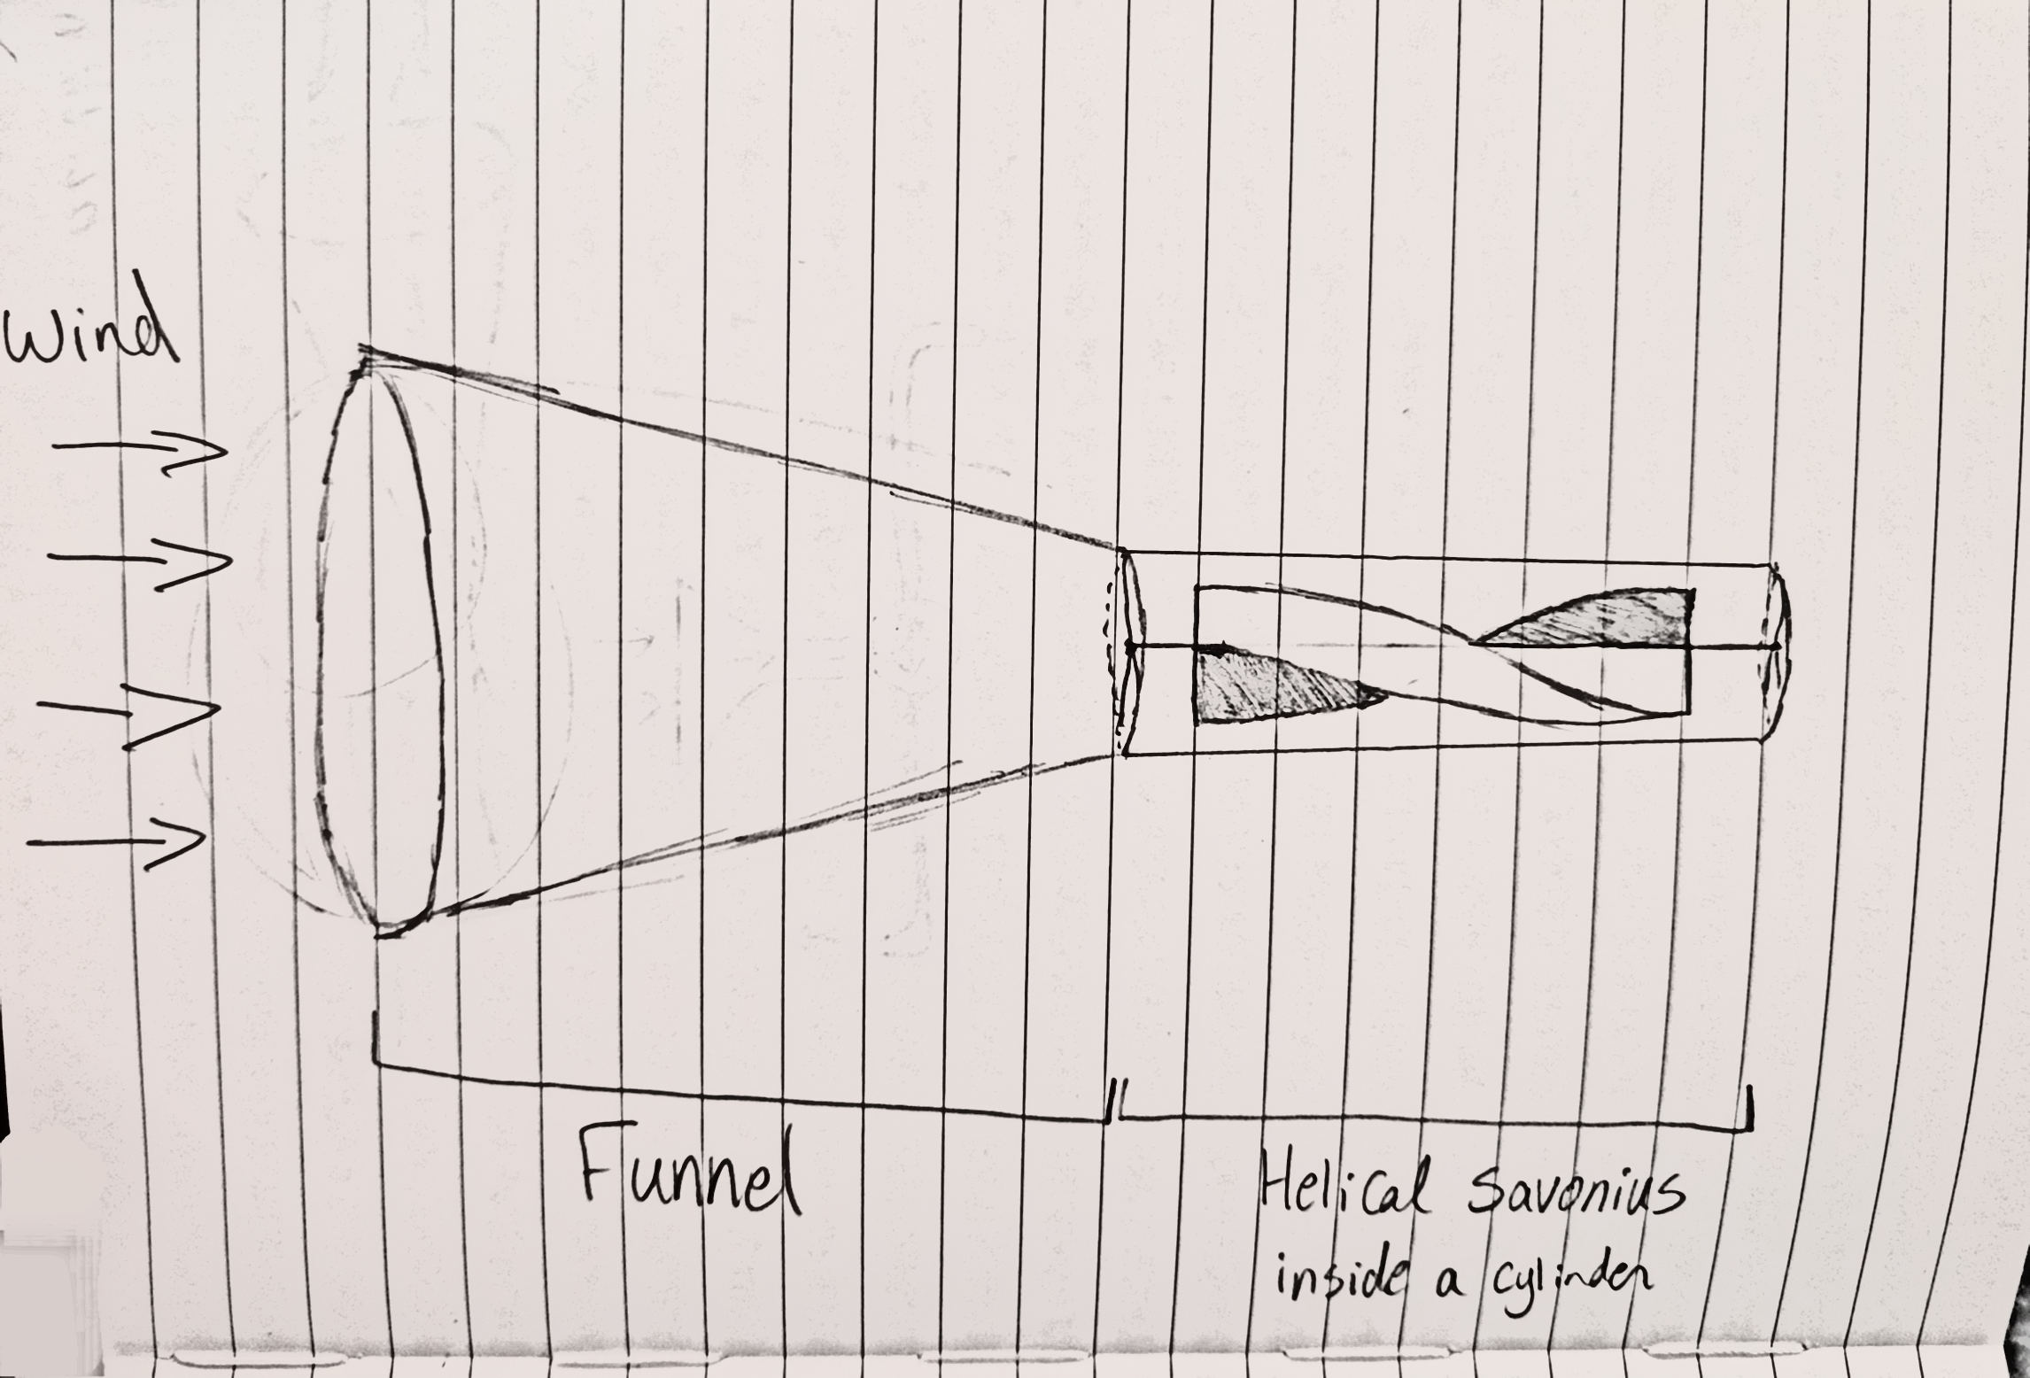
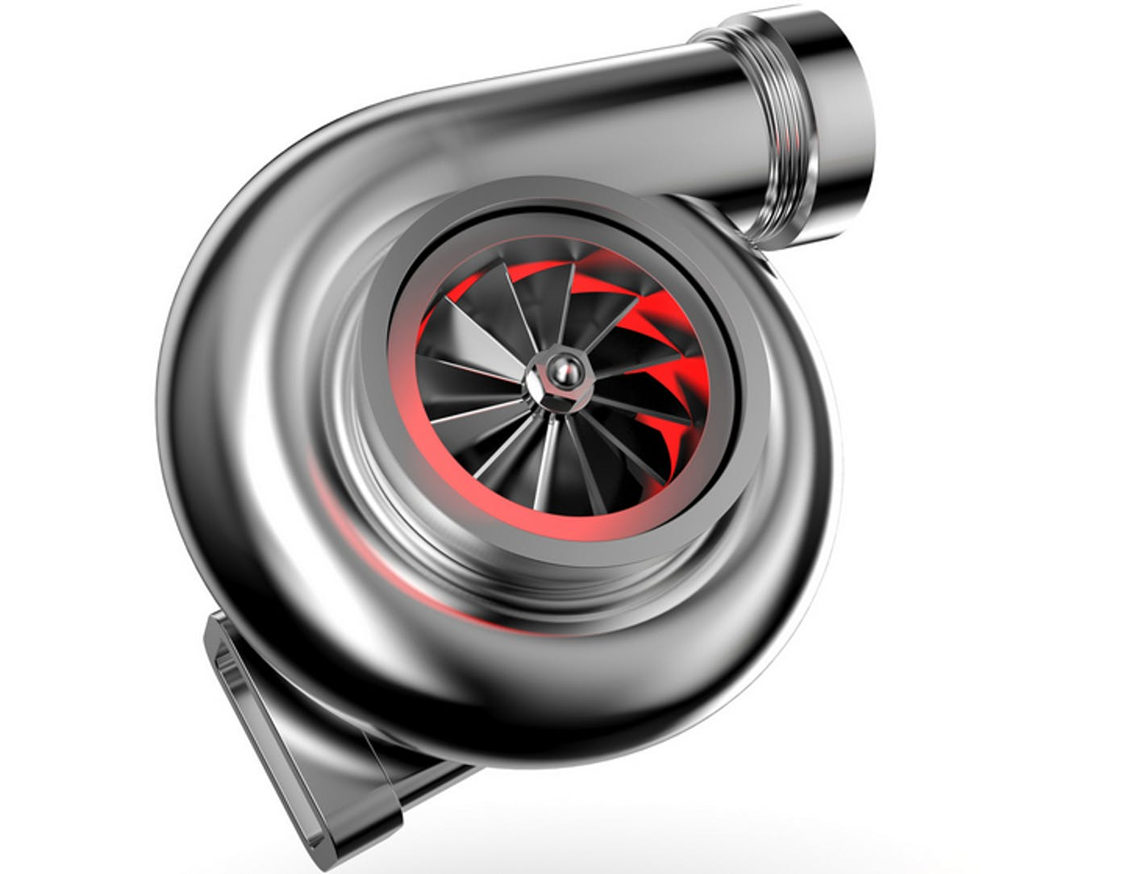
Designs
“Turbo”
“Straw” with a WGA
Helical Savonius with a WGA

Slide 5
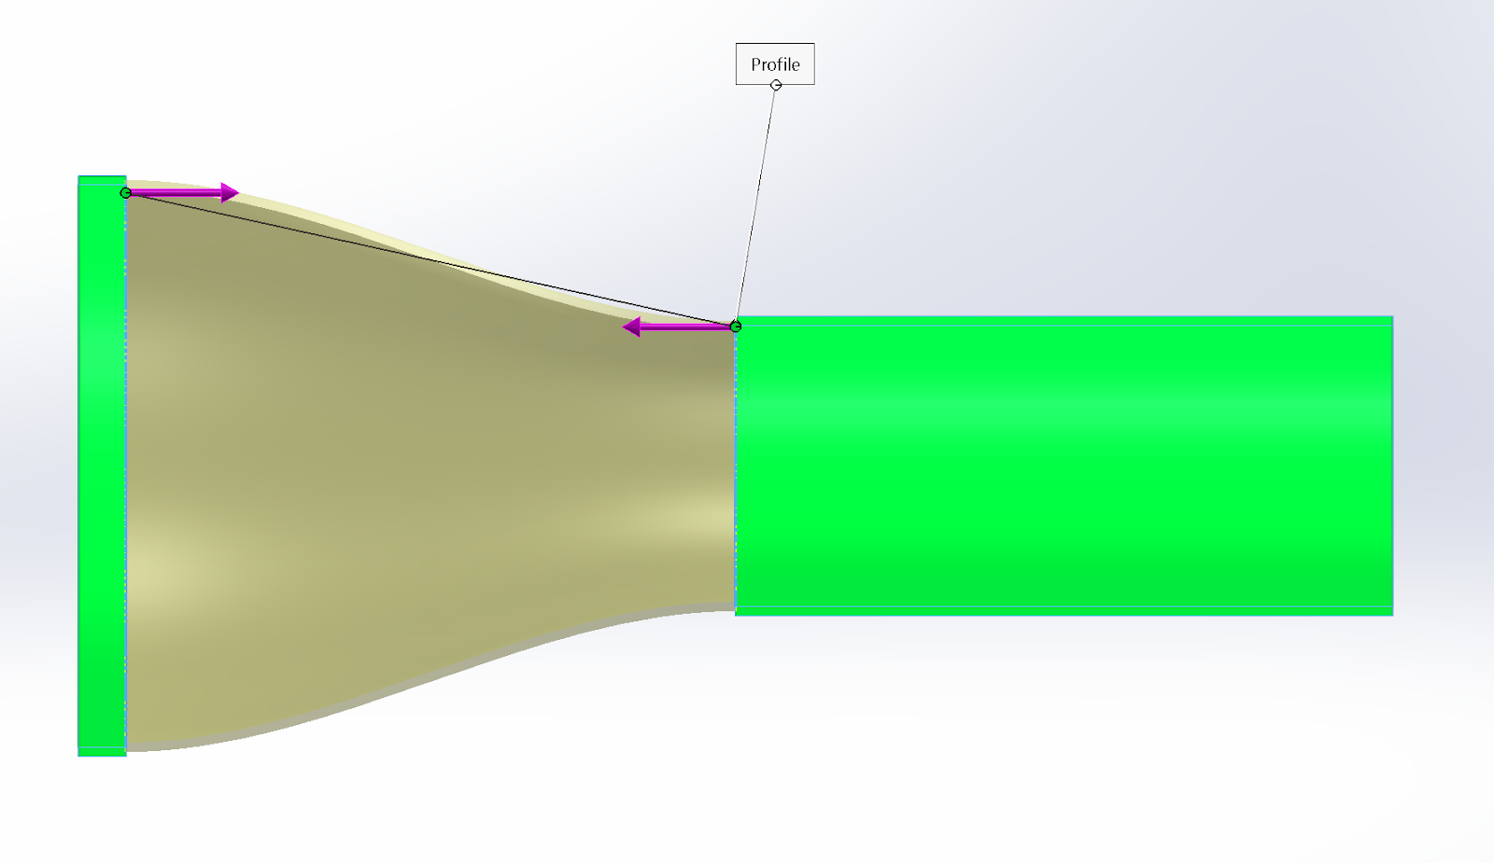
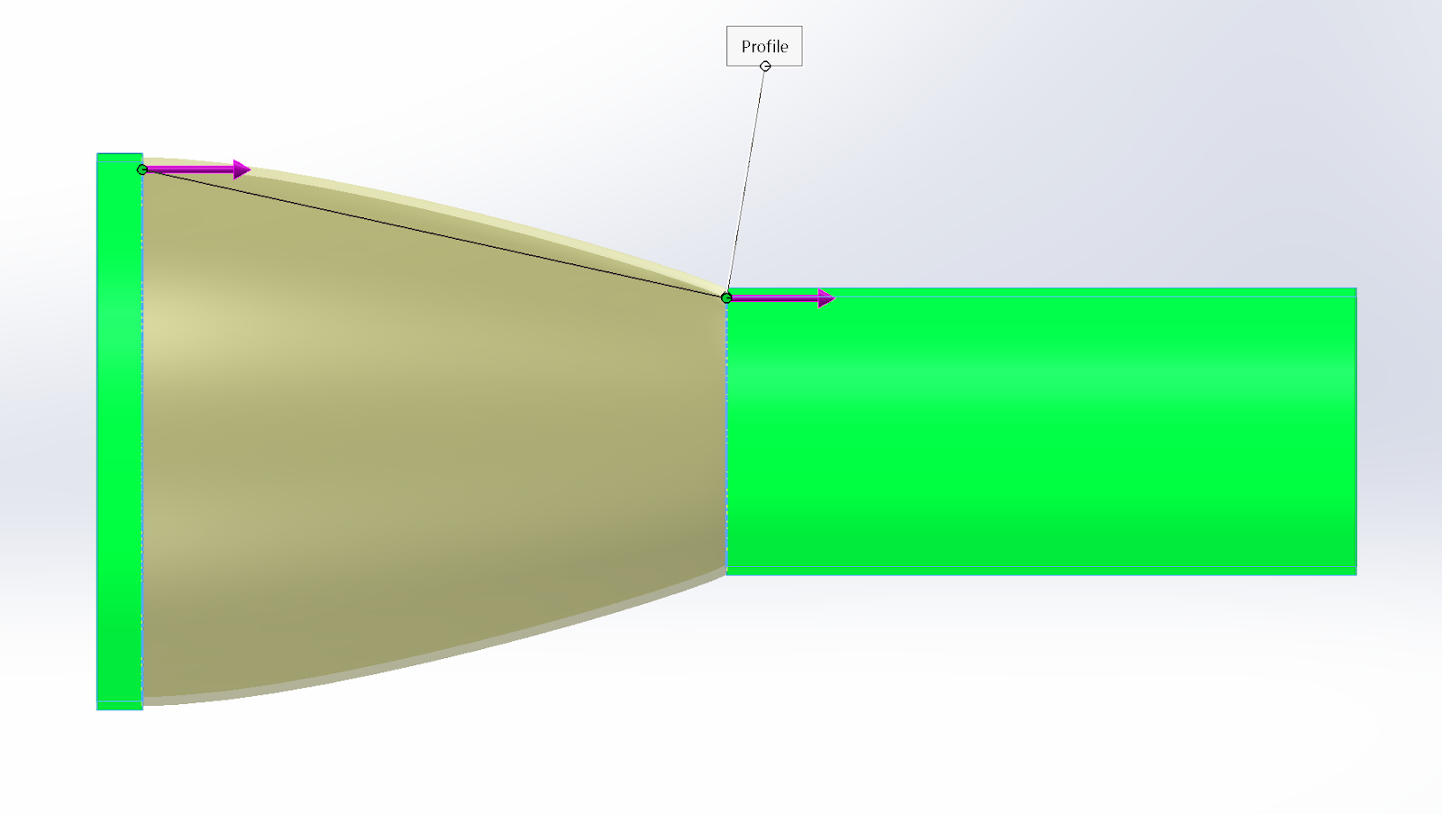
SolidWorks
Different types of WGA (wind guiding apparatus) curves
Design 1 Design 2
Hypothesis: Design 2 will be a more efficient solution due to the air direction only changing one time along the curve.

Slide 6
SolidWorks (Cont.)
Issues encountered
Design 2
Issue: The little notch on the inside is not supposed to be there.
Solution: Keenan Center suggested to manually draw the curve and revolve.

Slide 7
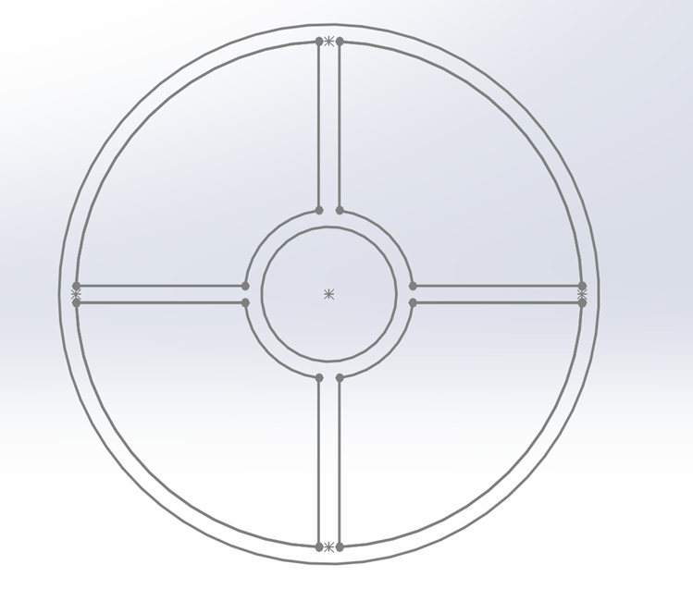
SolidWorks (cont.)
Bearing and Shaft Support
There will be two supports holding the bearings and shaft in place.
Sizing of the support and the whole apparatus is determined by the unchanged variable which is the bearing.

Slide 8
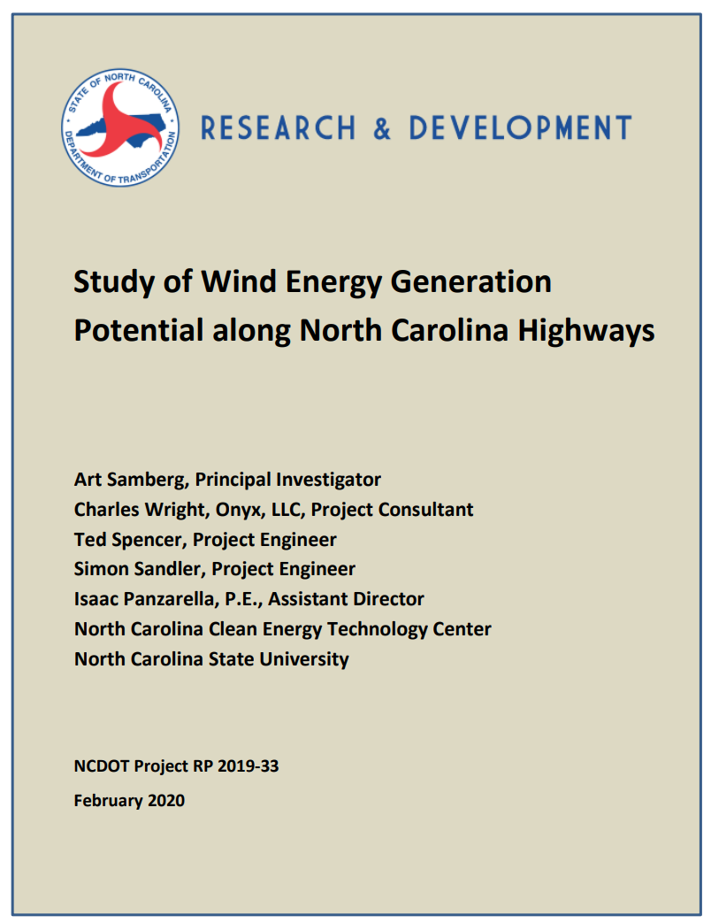
Research
Main takeaways:
The WGA makes a noticeable difference
Highway wind speed varies depending on the time of day
Max wind speed next to highways is about ~15 m/s

Slide 9
Purchaces
Bones Reds Big Balls Bearings
Anemometer
Bought these instead of the regular ones because these have 6 ball bearings instead of 7
Made by XRCLIF and it can measure wind speeds in M/s, Km/h, ft/min, Knots, Mph
Total Cost: $43.31

Slide 10
Project Timeline
Finish the WGA (wing guiding apparatus)
Due Oct 5th
Implement the shaft holder
Due Oct 12th
Design the blade
Due Oct 19th
Refine the blade parameters
Due Oct 27th
Simulate 3D Models with SolidWorks
Due Nov 15th
3D print & build
Due Nov 15th
Testing and Analysis
Due Nov 30

Slide 11
Questions?

