Slide 1
Philosophical Consequences in Quantum Mechanics
Jacob Cottet
9/27/2024
“The wavefunction, as given by the Schrödinger equation, is supposed to give a complete description of the physical world, but measurements always give definite outcomes. How then can a combination of possibilities turn into a single actuality?” - John S. Bell

Slide 2
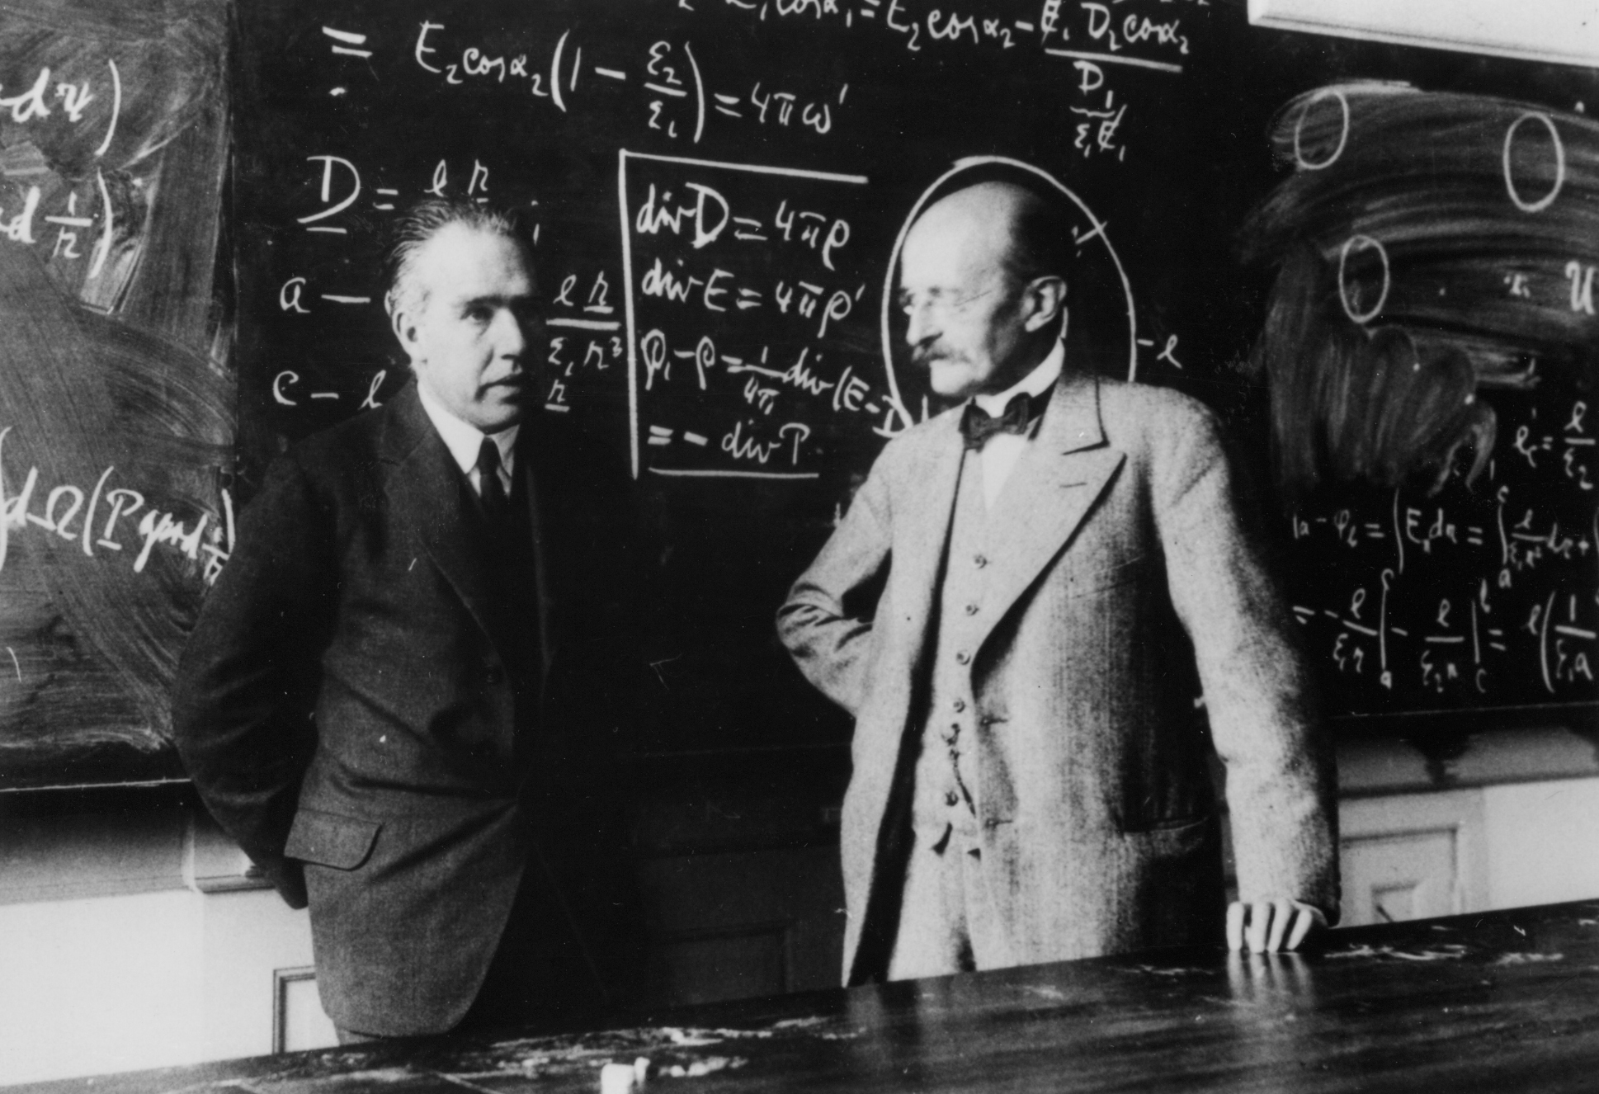
Agenda
Paper Outline, Refined
Research Process and Organization
Schedule, Revisited
Status Report
Short Term Goals

Slide 3
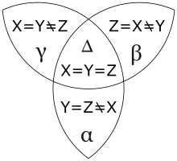
Paper Outline
Physics, Philosophy, and Their Respective Ends
Historical Context
Classical vs. Quantum; Fundamental Principles
General Introduction to Philosophical Quandaries in QM
The Copenhagen Interpretation
Bell’s Inequality/Theorem
Analysis/Conclusion

Slide 4
Research Organization
1. Notes on material → Notes Document → Notes by Topic
2. Paper Outline Document → Notes by Topic under Outline → Paper

Slide 5
Schedule
August - September
Research and write introductory sections
September - October 15
Research and write fundamental principles; begin researching Copenhagen/Bell
October 15 - November 15
Revisit and revise fundamental principles; research, write, revise Copenhagen/Bell
November 15 - December 6
Revisit and revise sections; supplemental research and writing as needed

Slide 6
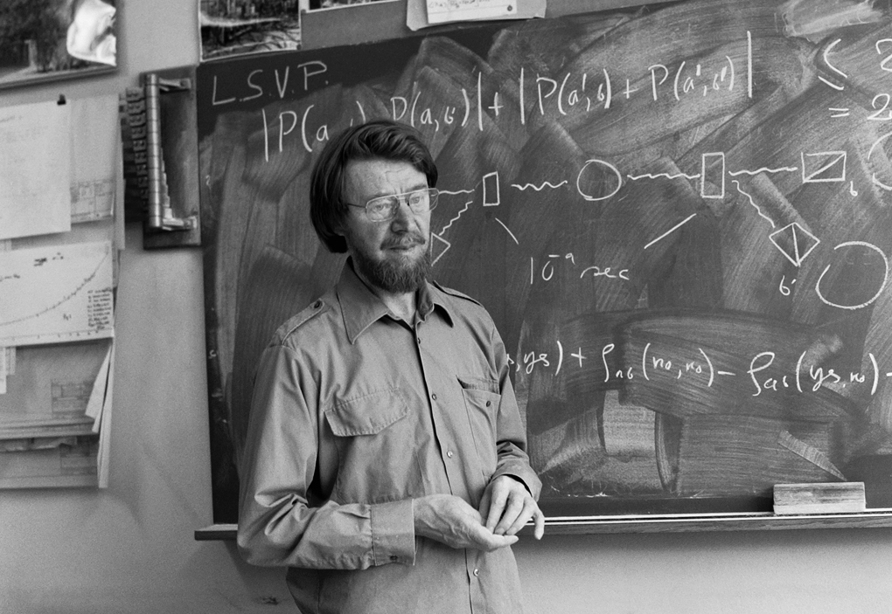
Status Report
1. Research & reading for introductory sections
Notes → Detailed Outline → Prose
2. Potentially looking to refine focus under Copenhagen Interpretation and Bell’s Theorem

Slide 7
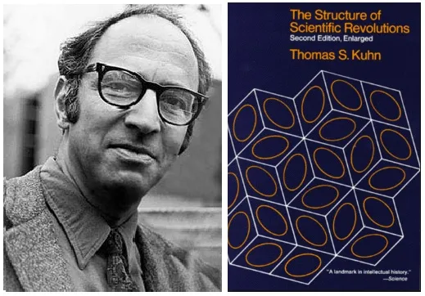
Thomas Kuhn — The Structure of Scientific Revolutions
Historian and philosopher of science
Published in 1962
Paradigm: a collection of theories, methods, and prevailing notions; how scientists approach solving problems and how solutions are interpreted
Paradigm Shifts: when the current paradigm can no longer accommodate anomalies and quandaries, a new paradigm emerges
Scientific progress is not linear, many little advancements lead to revolutionary paradigm shifts

Slide 8
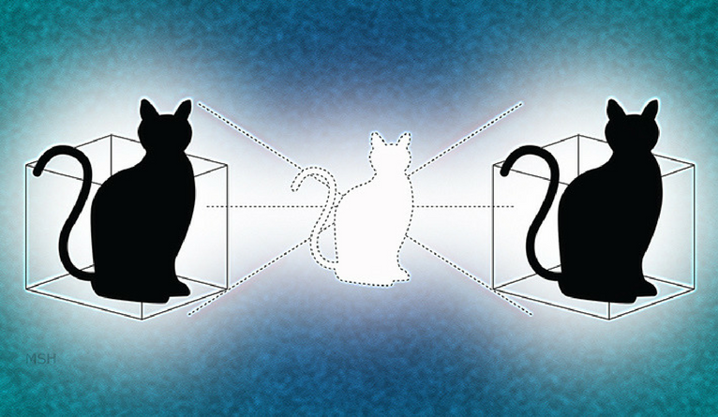
The Trilemma of Quantum Theory*
The wave function provides a complete description of the individual state.
The time evolution of the system is always given by the Schrodinger Equation.
Measurements have a definite outcome.
This questions governs every interpretation of QM
These all seem reasonable, but accepting two eliminates the remaining one
Interpretations involve either justifying why one tenet can be rejected, or by avoiding the trilemma altogether
*First posited by Tim Maudlin in 1995, this simplified version shown above was reformulated by Passon and von Strien in 2022

Slide 9
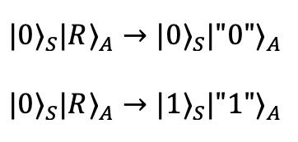
Philosophical Implications: Three General Categories
Determinism
(Im)possibility to observe/measure without intervening
Possibility of non-local interactions and the metaphysical & epistemological consequences
From Philosophical Issues in Quantum Theory - Stanford Encyclopedia of Philosophy

Slide 10
Short Term Goals
Next two weeks:
Wrap up preliminary research
First drafts of introductory sections
Begin general research into general philosophical implications
Begin in-depth research into CI & Bell’s Theorem
Get more materials on Bell’s Theorem

