Slide 1
Pantograph
Capstone
Elisa Hoffmann

Slide 2
Road Map
01
02
03
04
Research Progress
CAD/3D Design Progress
Milestone Overview
New
Timeline

Slide 3
01
Research Progress

Slide 4
Research Progress
History
Aerodynamics
Material Science
Completed
Awaiting final draft
Access to 6/11 sources
Started reading
Milestones adjusted accordingly
Access to 3/9 sources
(in addition to Thesis)
Milestones not adjusted– no impact

Slide 5
Key Ideas
History
Aerodynamics
Materials
Solution?
Innovation
Friction
Optimize
Drag and Lift
Electricity used for high-speed travel
More drag and lift causes increased contact with overhead wire
Optimization of aerodynamics and slide plate material
Higher speed causes more drag and lift

Slide 6
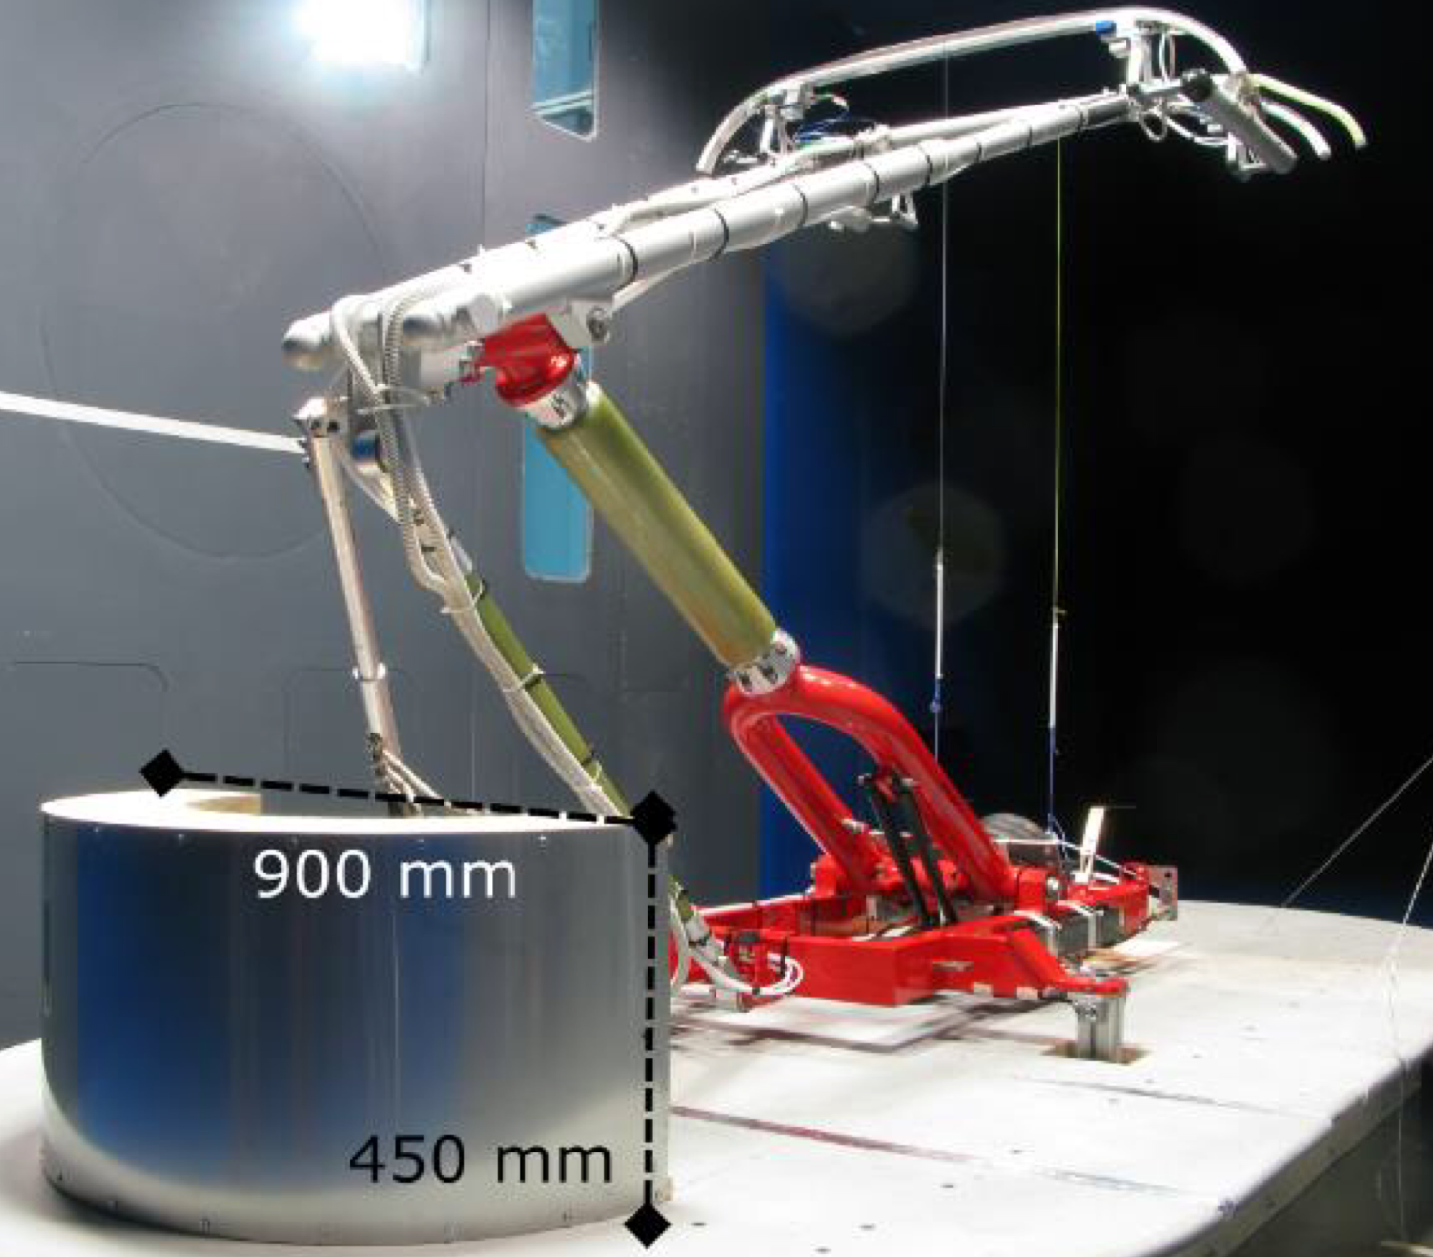
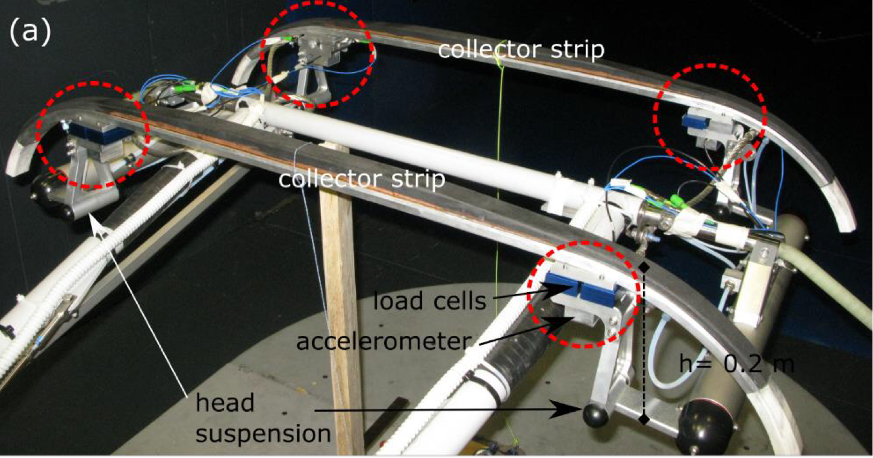
[1]

Slide 7
02
CAD/3D Design Progress

Slide 8
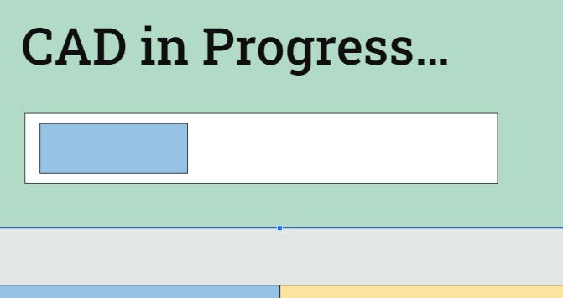
3D Printing Experiment
Still focused on research, but conducted 3D printing experiment

Slide 9
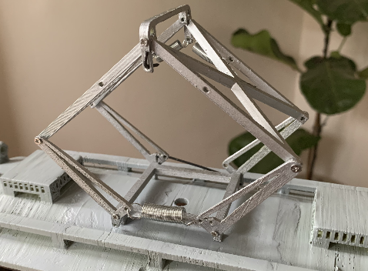
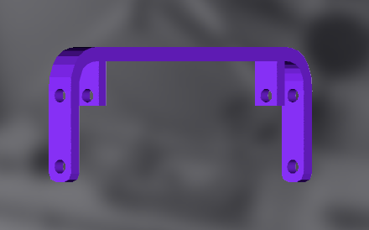
[2]

Slide 10
03
Milestone Overview

Slide 11
Milestone Overview
Capstone
Physics
3D Design
Testing
Research and formulas to predict lift & drag
Producing at least two models of pantograph
Performing and concluding results
Fan and force sensor
Additional: software simulation
Aerodynamics
Material Science
Wing design
Lower arm design

Slide 12
Milestone Progress
40%
25%
2%
Research
CAD/3D Print
Tests
History
Aerodynamics
Material Science
Sample structure
CAD editing
3D Printing
Fan and force sensor
Software tests

Slide 13
04
New Timeline

Slide 14
Phases of the Capstone
Phase 1
Phase 2
Research and Design
Print and Test
Research
Design
Print
Test
Completed by:
Oct. 15th
Completed by:
Oct. 20th
Completed by:
Nov. 1st
Completed by:
Nov. 30

Slide 15
Thank you!
Questions?

Slide 16
References
[1] https://doi.org/10.1016/j.jweia.2016.11.003
[2] https://cults3d.com/en/3d-model/game/scherenstromabnehmer-spur-g-spur-1

