Slide 1
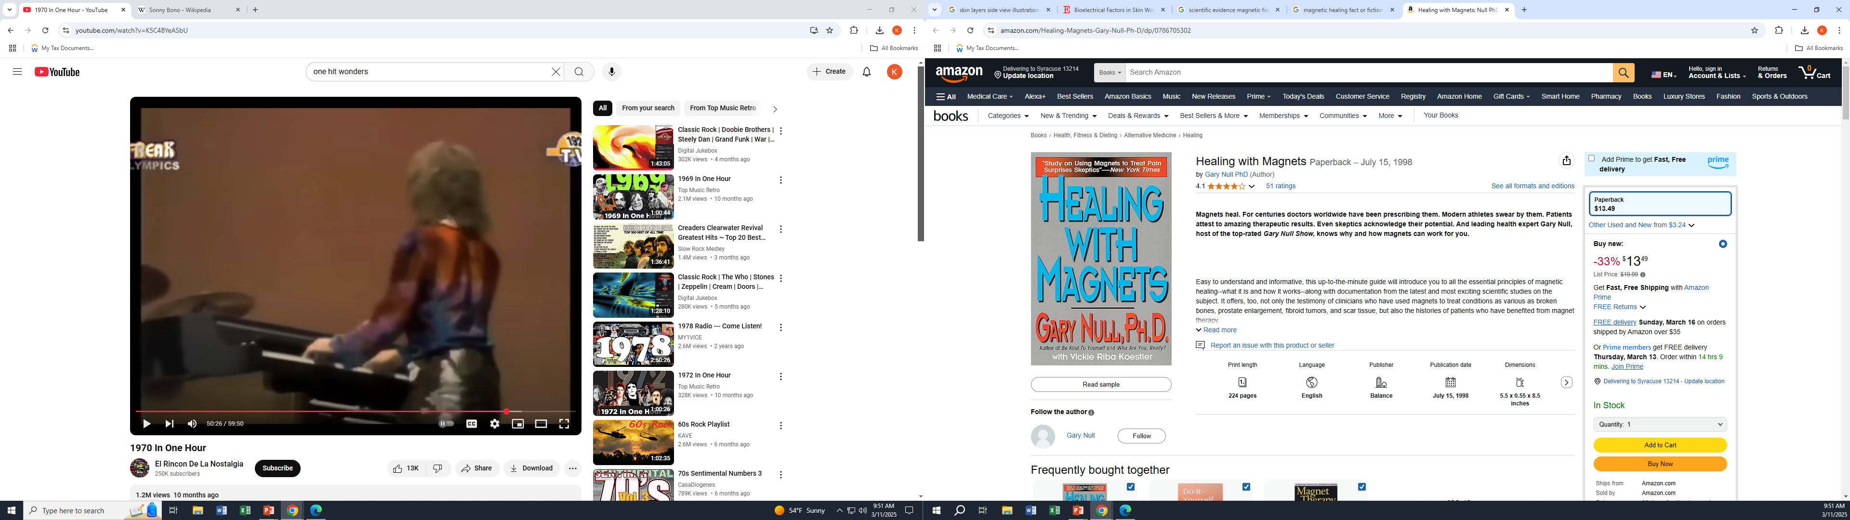
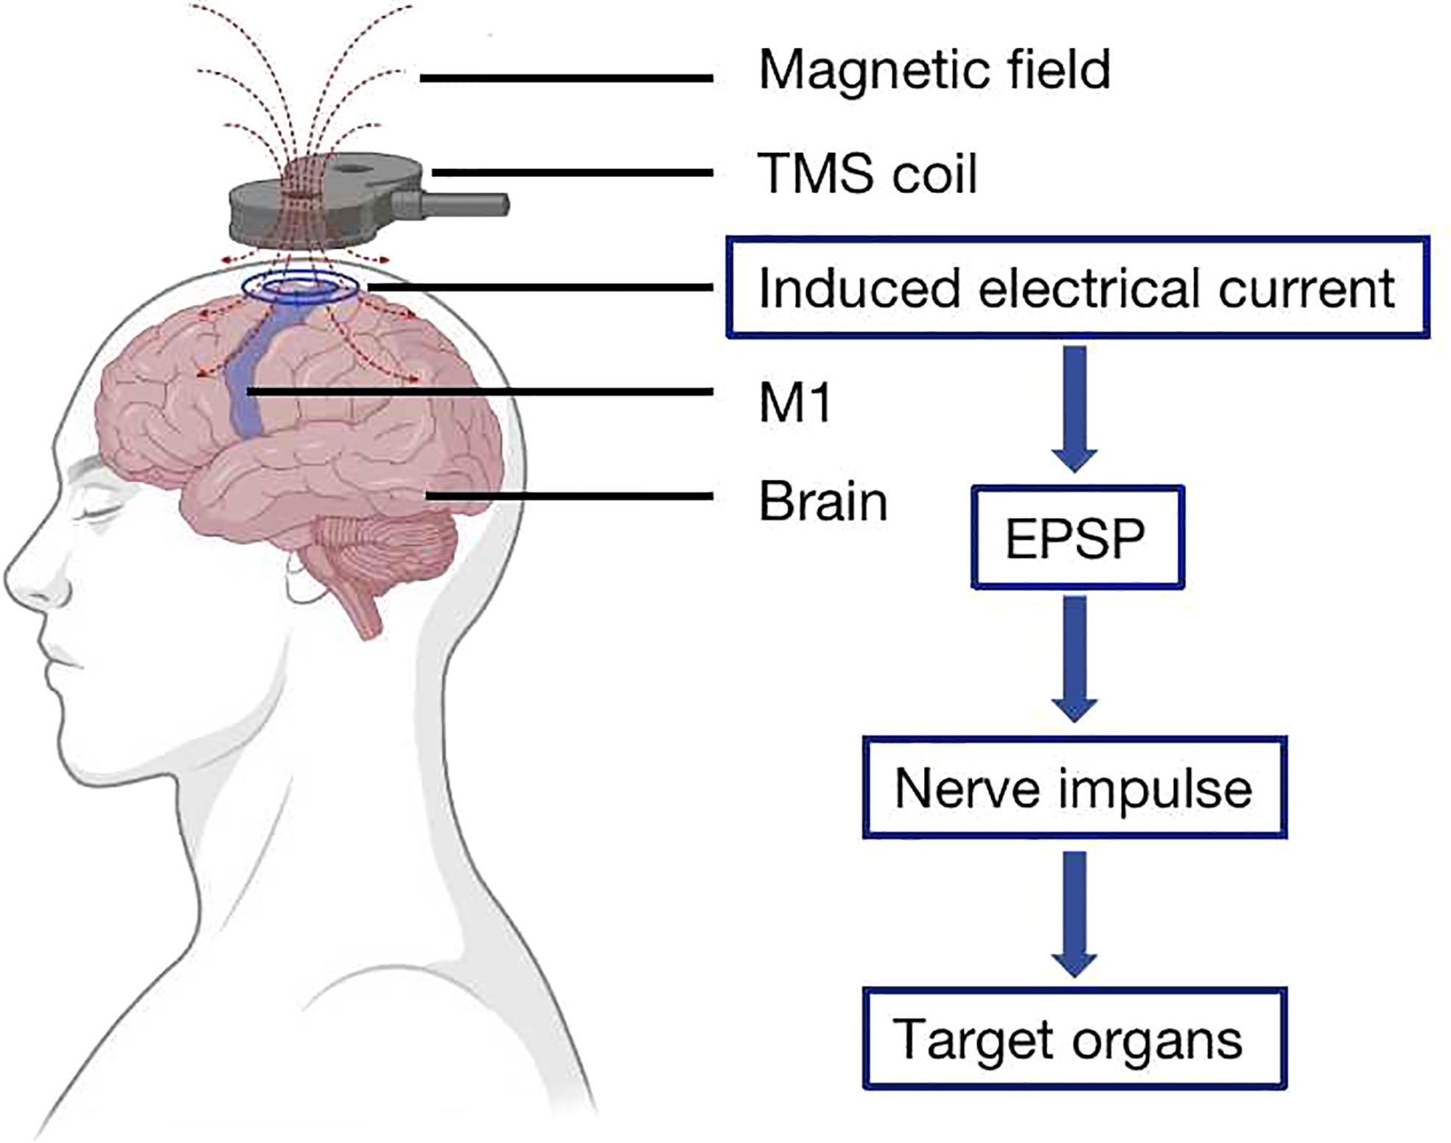
Our bodies have charged particles (H⁺, e-, ions) that move throughout:
Charged particles + movement create Magnetic fields
External Magnetic fields can produce forces on moving charges
Null holds an associate degree in business administration from the two-year, for-profit Mountain State College in Parkersburg, West Virginia, and a Ph.D. program in human nutrition from Union Institute & University,^{[7]} a private distance-learning college. Null's academic credentials were investigated due to sharp skepticism about the school’s quality and the quality of his PhD thesis. … And there’s more … much more about “leading expert” Gary Null.
Do you think magnets have healing powers?
Amazon: $13.49
Some uses of magnetic fields currently being explored and investigated
Pain Management:
Magnetic Therapy: Some practitioners believe that applying magnets to the body can help reduce pain, although scientific evidence supporting this is limited.
Pulsed Electromagnetic Field (PEMF) Therapy: PEMF therapy uses pulsed magnetic fields to treat conditions like chronic pain, arthritis, and fibromyalgia.
Conditions Treated: PEMF therapy is used to treat strains, sprains, bursitis, epicondylitis, traumatic injuries, and repetitive strain disorders.
Fracture Healing:
PEMF for Non-Union Fractures: PEMF therapy is used to stimulate bone healing in cases of slow-healing or non-union fractures.
Mental Health Conditions:
Transcranial Magnetic Stimulation (TMS): TMS uses magnetic fields to stimulate nerve cells in the brain, improving symptoms of major depression.
rTMS: Repetitive TMS (rTMS) involves repeated magnetic pulses and is investigated for treating neurological conditions like Parkinson's disease and stroke rehab.
Other Applications:
Magnetic Nanoparticles (MNPs): MNPs are used in cancer theranostics, hyperthermia treatment, drug delivery, and biosensing.
MRI Scanners: MRI scanners use strong magnetic fields to create detailed images of the body.
Orthopedics and Maxillofacial Applications: Magnets are used in orthopedics for fracture healing and in maxillofacial applications.

Slide 2
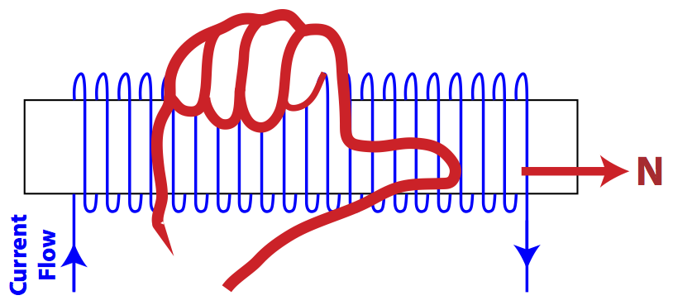
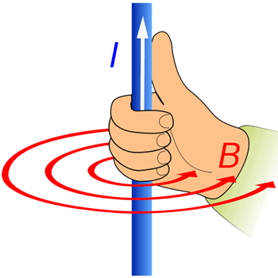
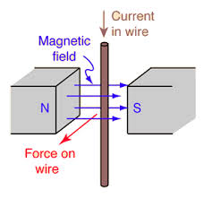
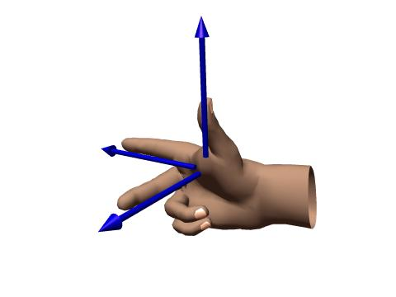
Wrap your fingers of your right hand in the direction of the current, your thumb points in the direction of the magnetic field inside the loops
Point your thumb of your right hand in the direction of the current. Your fingers of your right hand wrap in the direction of the circular magnetic field around the wire.
-
Right-hand Rule 2A
Right-hand Rule 2B
weaker B field farther from wire
stronger
B field
+
-
+
A POSITIVE charge, q₊, moving with velocity, v, in an external magnetic field, B_{external}, will feel a force, F, perpendicular to both the direction of the velocity and magnetic field. Point your index finger in the direction of the POSITIVE charge’s velocity, middle finger in the direction of the external magnetic field. Your thumb will point in the direction of the force the POSITIVE charge feels. You can replace q₊v with a current in a wire, I, times the length of wire, L, that’s in the B field.
Right-hand Rule 1A
F
Right-hand Rule 1B
These equations give the magnitude of the force on a moving charge or current carrying wire in an external B field
F = q₊v ^{x} B_{external}
F = IL ^{x} B_{external}
q₊v
middle finger
B_{external}
thumb
index finger

Slide 3
8. You are standing on the equator of the Earth when a positive charge flies past you moving from East to West. The Earth's magnetic field causes a magnetic force on the charge. Use Right Hand Rule #1 to determine the direction of the magnetic force on the particle. Choose from East, West, North, South, Up toward the sky, and Down toward the center of the Earth.
Earth’s North Pole
A POSITIVE charge, q₊, moving with velocity, v, in an external magnetic field, B, will feel a force, F, perpendicular to both the direction of the velocity and magnetic field. Point your index finger in the direction of the POSITIVE charge’s velocity, middle finger in the direction of the magnetic field. Your thumb will point in the direction of the force the POSITIVE charge feels. You can replace q₊v with a current in a wire, I, times the length of wire, L, that’s in the B field.
Looking Down -
Bird’s eye view
Earth’s Magnetic field, B_{external}
Earth’s Magnetic SOUTH Pole is at earth’s GEOGRAPHIC North pole
F
q₊v
west
east
Force on charge is into the page
q₊v
B_{external}
these equations give the
magnitude of the force on a moving charge or current carrying wire in an external B field
F = q₊v ^{x} B_{external}
F = IL ^{x} B_{external}
Earth’s South Pole

Slide 4
10. You are standing on the equator of the Earth, facing North, and a long, straight, horizontal wire is suspended about 2 meters in front of you at shoulder height and runs East-West. It carries a current which flows from East to West. The same positively charged particle as in the earlier question flies past you at shoulder height (exactly the same height as the wire), traveling from East to West (parallel to the wire), about 1 meter in front of you. a) Find B field of wire. b) Find the direction of the force on +q from B field of wire
F
Magnetic field from wire, B_{external} is into of the page here
Looking Down -
Bird’s eye view
q₊v
I
B_{external}
Force on charge due to the magnetic field caused by the current carrying wire is toward the wire
west
east
q₊v
●
●
●
●
+
Magnetic field from wire, B_{external} is out of the page here
Earth’s South Pole

Slide 5
13. Positive particles move in a circle in the direction shown in the diagram. What is the direction of the (external) magnetic field? Choose from (i) perpendicular up out of this page or (ii) perpendicular down into this page. Explain
External Magnetic field from wire, B_{external} is into the page
F
q₊v
q₊v
Force on charge toward center
B_{external}

Slide 6
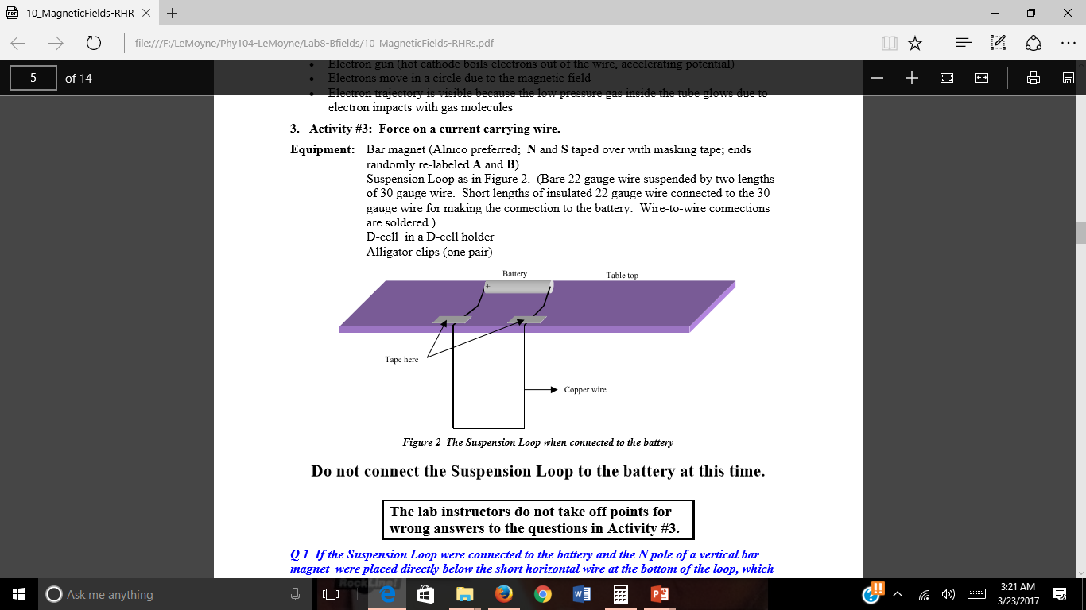
Activity #3: Force on a current carrying wire
Power Supply (2.5A)
Power Supply (2.5A)
+
+
DO NOT REMOVE THE TAPE FROM THE PERMANENT MAGNETS!!
N
S
S
N
Which direction is the current flowing in the wire segment that’s closest to the magnet?
Which direction is the EXTERNAL B field from the magnet pointing? See Introduction O.3
Use Right-Hand-Rule 1B to find the force and deflection of the wire.

Slide 7
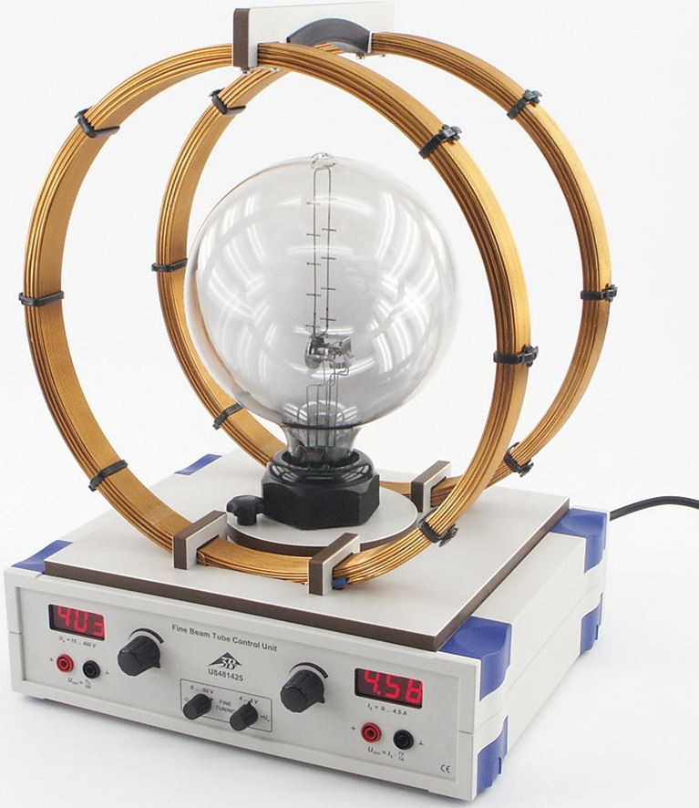
Activity #4: Electron beam moving in a magnetic field
External coils supply an EXTERNAL magnetic field
Electrons move in a counterclockwise circular path
Electric (Conventional) current (+q’s) would move in a CLOCKWISE circular path
Force on the electrons and +q’s is toward the center of the circular path.
Use Right-hand Rule 2A or 2B to find the magnetic field caused by the electrons only. The external coils and their current flow and magnetic fields ARE NOT INCLUDED HERE. Consider the electrons as a CLOCKWISE flowing current in one loop (RHR 2A) or consider each small segment of the electron path as a short straight wire (current flows in the opposite direction than electron flow) (RHR 2B)
To find the direction of the EXTERNAL B FIELD caused by the coils, do not use the B field from due to the electrons found in step 5 above. Consider ONE point on the circular path: Find the direction of q₊v at that point assuming a positive charge (convetional current direction). The direction of the force on +q is known at that point. Use Right-hand-Rule 1 to find the external B field from the large coils. (Similar to pre-lab Ques. 13)
e-
+

Slide 8
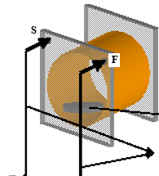
Activity #6: Tracing the field of a magnet and of a coil with a compass
Turn the power supply voltage Counterclockwise before connecting to the coil.
Connect the Red power supply plug to “S” of the coil.
Connect the BLACK power supply plug to “F” of the coil
Turn the power supply up to about 5 Volts.
The direction of the current through the coil is shown with black arrows on the side of the coil.
Use the permanent magnet to determine how the compass reacts to the North pole of a magnet. Does the compass needle tip point toward a north pole or does the compass needle tail point toward a north pole?
After testing the compass, move the permanent magnet far from the coil.
For Q15, orient the coil like the coil below.
Power Supply
BLACK
Red
-
+

Slide 9
Wrap your fingers of your right hand in the direction of the current, your thumb points in the direction of the magnetic field inside the loops
Point your thumb of your right hand in the direction of the current. Your fingers of your right hand wrap in the direction of the circular magnetic field around the wire.
-
Right-hand Rule 2A
Right-hand Rule 2B
weaker B field farther from wire
stronger
B field
+
-
+
A POSITIVE charge, q₊, moving with velocity, v, in an external magnetic field, B_{external}, will feel a force, F, perpendicular to both the direction of the velocity and magnetic field. Point your index finger in the direction of the POSITIVE charge’s velocity, middle finger in the direction of the external magnetic field. Your thumb will point in the direction of the force the POSITIVE charge feels. You can replace q₊v with a current in a wire, I, times the length of wire, L, that’s in the B field.
Right-hand Rule 1A
F
Right-hand Rule 1B
These equations give the magnitude of the force on a moving charge or current carrying wire in an external B field
F = q₊v ^{x} B_{external}
F = IL ^{x} B_{external}
q₊v
middle finger
B_{external}
thumb
index finger

